Slide 1
Chapter 3 Selections
Liang, Introduction to Java Programming, Tenth Edition, (c) 2015 Pearson Education, Inc. All rights reserved.

Slide 2
Problem: Lottery
Write a program that randomly generates a lottery of a two-digit number, prompts the user to enter a two-digit number, and determines whether the user wins according to the following rule:
If the user input matches the lottery in exact order, the award is $10,000.
If the user input matches the lottery, the award is $3,000.
If one digit in the user input matches a digit in the lottery, the award is $1,000.
Lottery
Run

Slide 3
Listing 3.8
Pages 100-101
Lottery.java

Slide 4
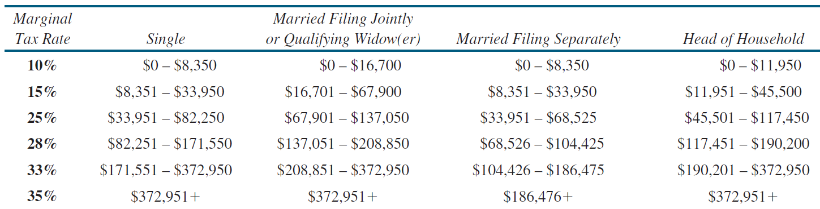
Problem: Computing Taxes
The US federal personal income tax is calculated based on the filing status and taxable income. There are four filing statuses: single filers, married filing jointly, married filing separately, and head of household. The tax rates for 2009 are shown below.

Slide 5
Problem: Computing Taxes, cont.
if (status == 0) {
// Compute tax for single filers
}
else if (status == 1) {
// Compute tax for married file jointly
// or qualifying widow(er)
}
else if (status == 2) {
// Compute tax for married file separately
}
else if (status == 3) {
// Compute tax for head of household
}
else {
// Display wrong status
}
ComputeTax
Run

Slide 6
switch Statements
switch (status) {
case 0: compute taxes for single filers;
break;
case 1: compute taxes for married file jointly;
break;
case 2: compute taxes for married file separately;
break;
case 3: compute taxes for head of household;
break;
default: System.out.println("Errors: invalid status");
System.exit(1);
}

Slide 7
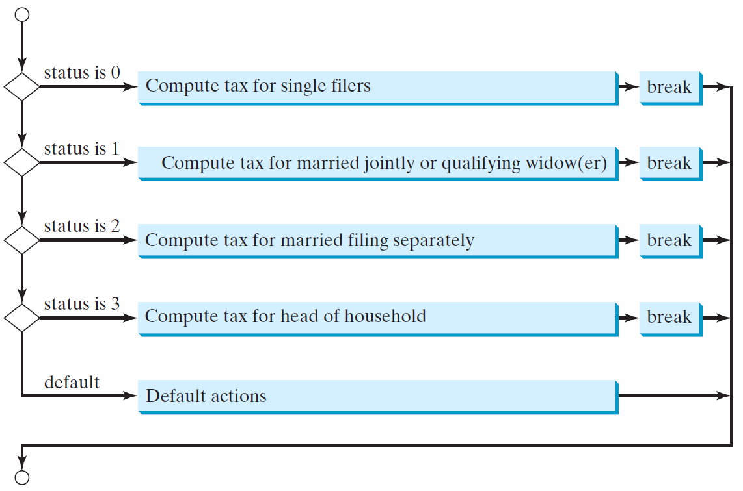
switch Statement Flow Chart

Slide 8
Trace switch statement
animation
Suppose day is 2:
switch (day) {
case 1:
case 2:
case 3:
case 4:
case 5: System.out.println("Weekday"); break;
case 0:
case 6: System.out.println("Weekend");
}

Slide 9
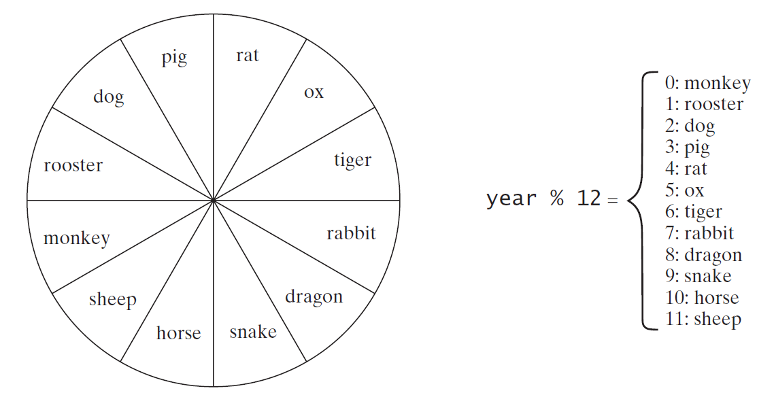
Problem: Chinese Zodiac
Write a program that prompts the user to enter a year and displays the animal for the year.
ChineseZodiac
Run

Slide 10
Listing 3.9
Page 104
ChineseZodiac.java

